Slide 1
Angular Topics
Template Reference Variable
Two way Data Binding

Slide 2
Template Reference Variable
The Template reference variable is a reference to any DOM element, component or a directive in the Template.
We can use it elsewhere in the template.
We can also pass it to a method in the component.
We declare Template reference variables using # followed by the name of the variable ( #variable).

Slide 3
Two-Way Data Binding
In two-way data binding, automatic synchronization of data happens between the class file and the Html file.
Here, change is reflected in both components.
Whenever you make changes in the class file, it will be reflected in the Html file and when you make changes in Html file, it will be reflected in class file.
This happens immediately and automatically, ensures that the Html template and the Typescript code are updated at all times.

Slide 4
Two-Way Data Binding
ngModel directive is used to achieve two-way data binding.
Must import Forms Module from ‘@angular/forms’.
[ ] -> Property Binding
( ) -> Event Binding
Two-way Data Binding = Property Binding + Event Binding
= [ ] + ( )
= [ ( ) ]

Slide 5
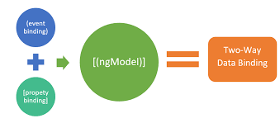
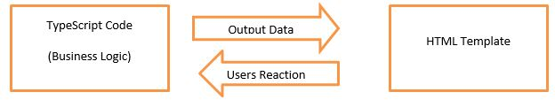

Slide 6
Thank you
Presented By
Patnana Santosh Kumar

